Slide 1
Group 2 - the American Alligator, Chicken, and Leatherback Sea Turtle
By Alicia, Dalia, Khadeja, and Tarunima
Notes:
dalia

Slide 2
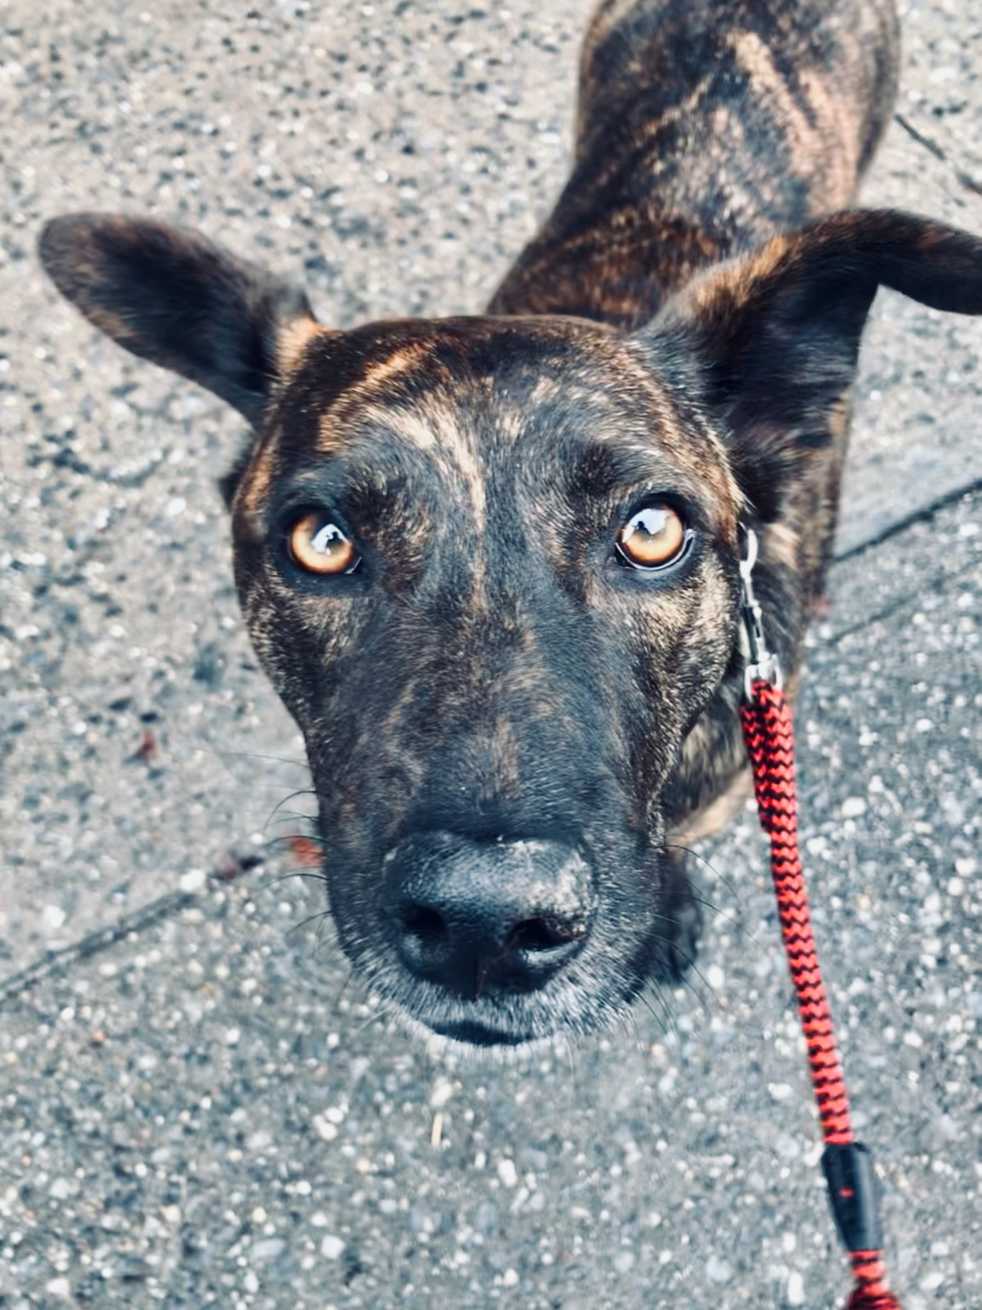

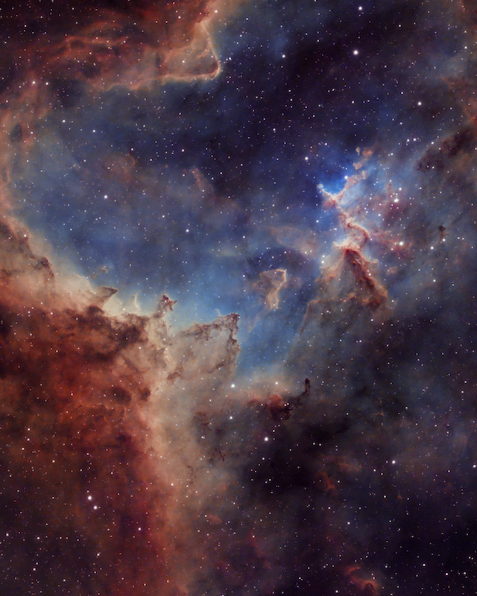
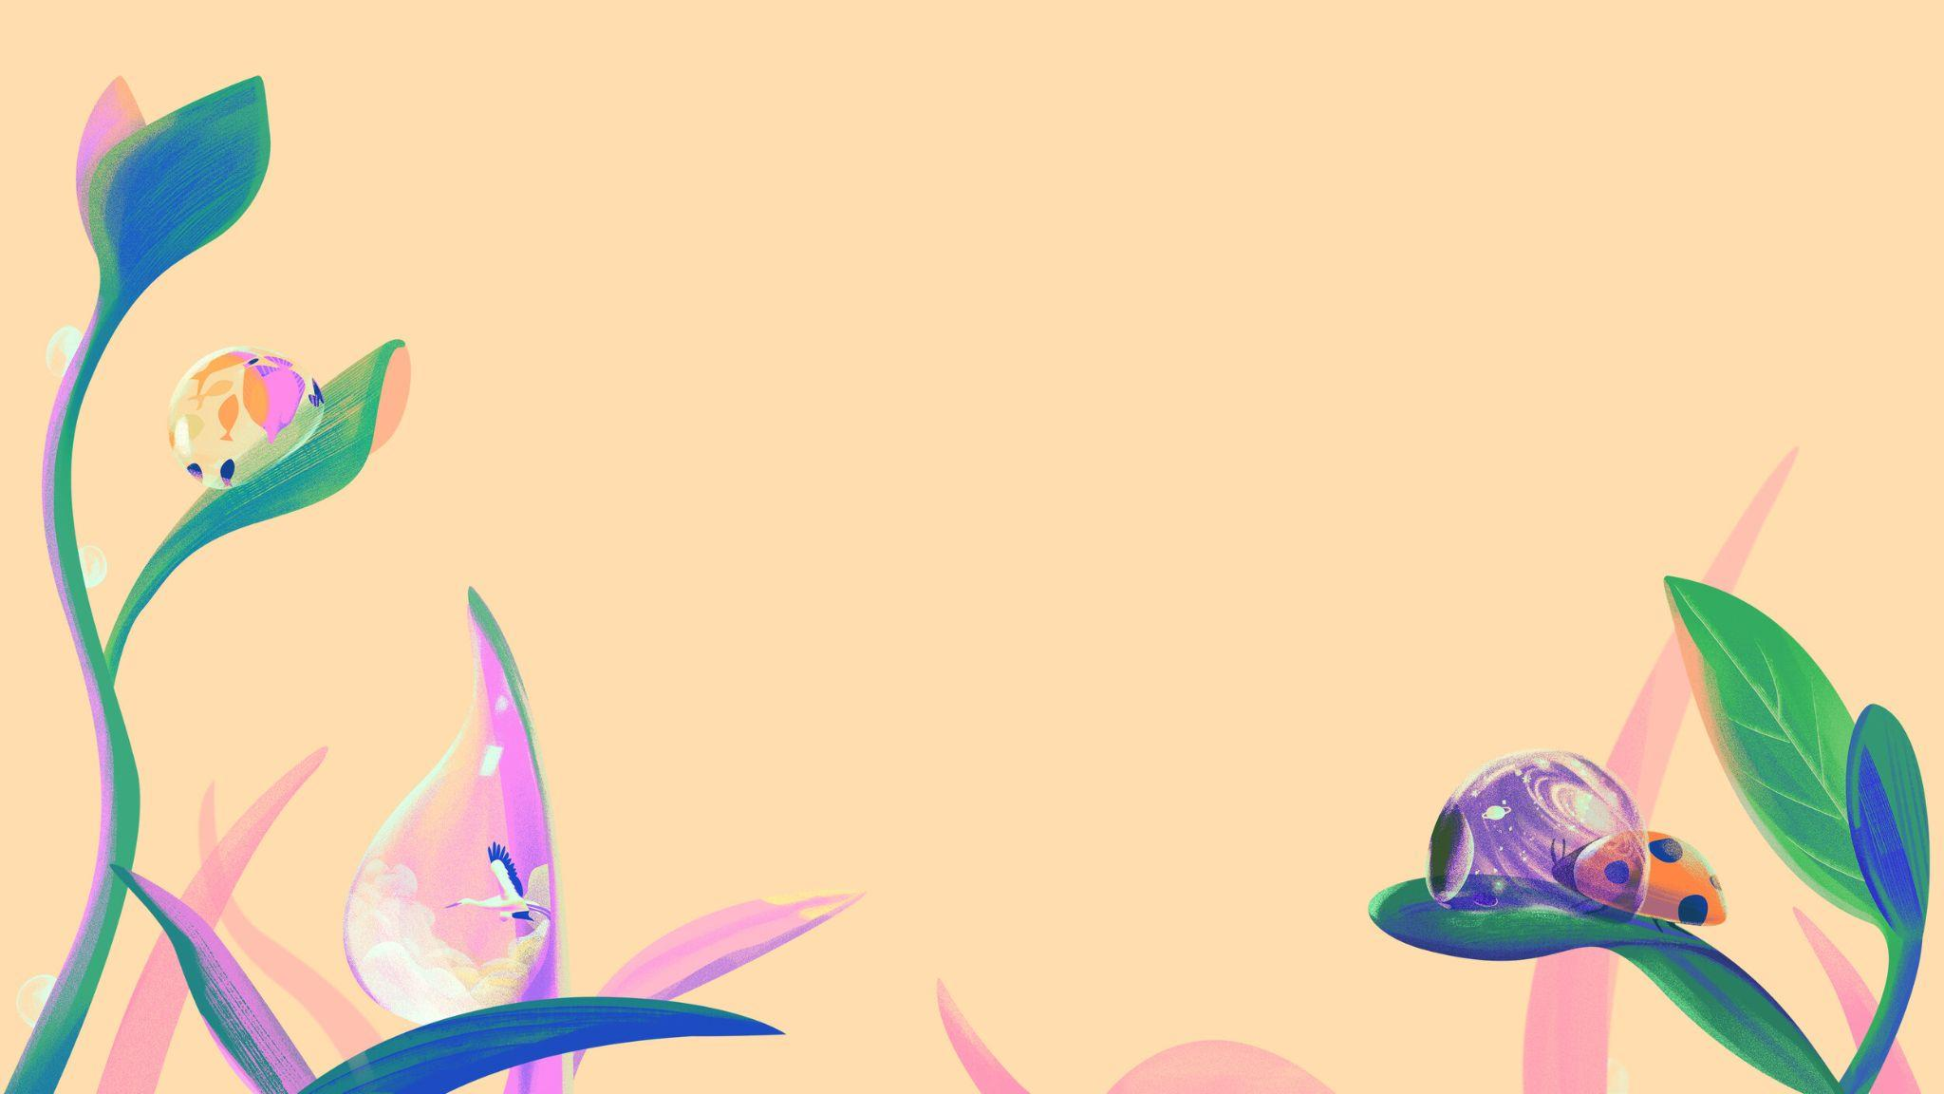
Meet the team
Alicia
Dalia
Tarunima
Khadeja
Coding, bonus challenge and bar graph coder, presentation theme
Coding presenter, coding, leatherback sea turtle researcher and slide
Coding, American Alligator researcher and slide, presentation’s font
Coding, slides presenter, Chicken research, bonus challenge
Notes:
Everyone say their name and what they did

Slide 3
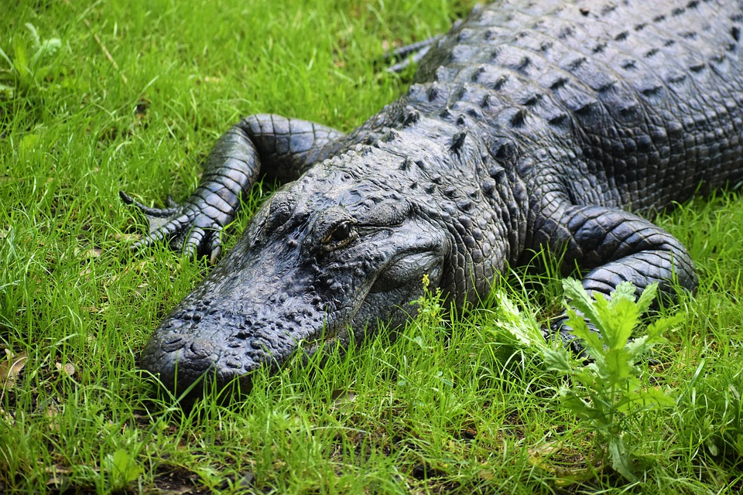
American Alligator
Scientific Name:
Alligator mississippiensis
Habitat:
Freshwater, slow-moving rivers. It can also be found in freshwater swamps, marshes, and lakes
Diet:
Fish, turtles, snakes, and small mammals
Life Span:
30 to 50 years in the wild
Native to?
Southeastern United States.
Notes:
Taru
American alligators are apex predators and consume fish, amphibians, reptiles, birds, and mammals. Hatchlings feed mostly on invertebrates. They play an important role as ecosystem engineers in wetland ecosystems through the creation of alligator holes, which provide both wet and dry habitats for other organisms.

Slide 4
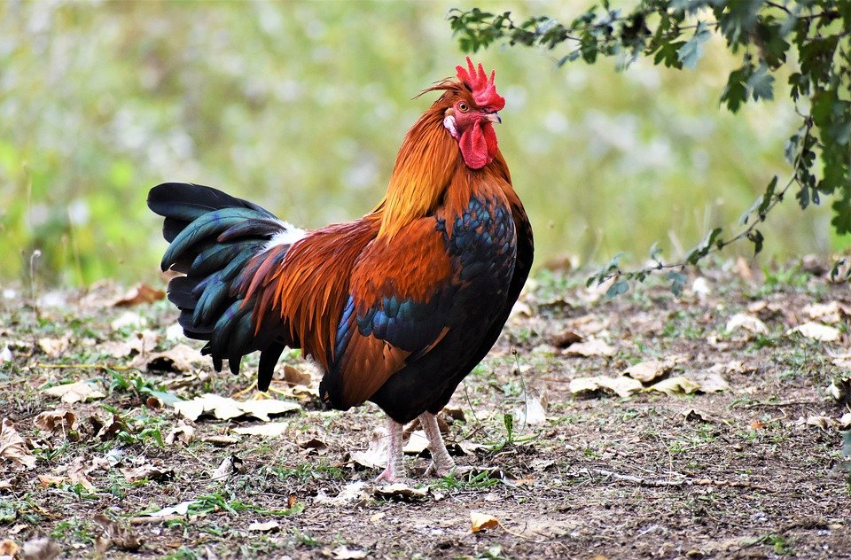
Chicken
Scientific Name:
Gallus Gallus Domesticus
Habitat:
Farms, Backyards
Diet:
Fruits, vegetables, grains.
Life Span:
5-10 Years
Native to?
Southeast Asia-Southwest China
Notes:
Khadeja
The chicken, a subspecies of the red junglefowl, is a type of domesticated fowl, originally from Southeastern Asia. originally, chickens were raised for cockfighting or for special ceremonies, and they weren’t used for food until the Hellenistic period.

Slide 5
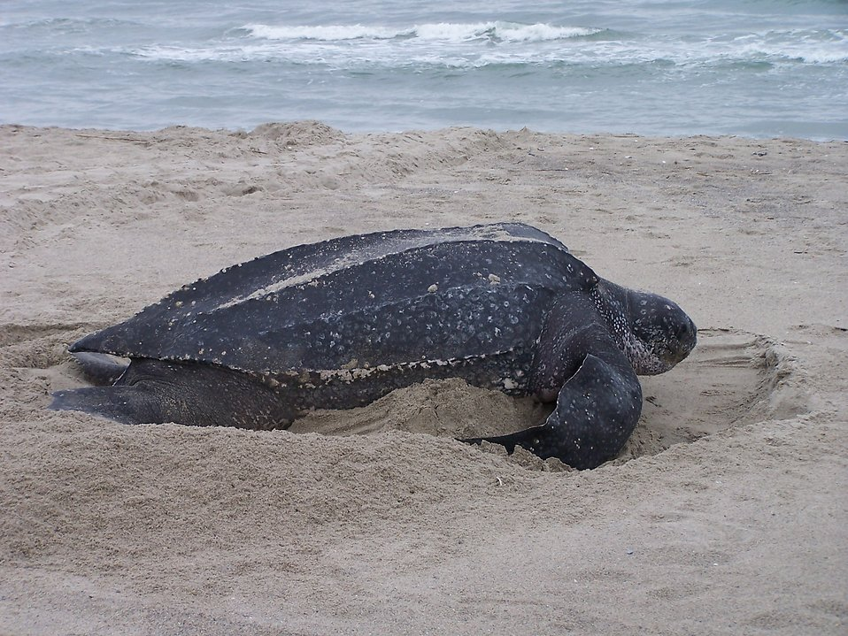
Leatherback Sea Turtle
Scientific Name:
Habita Dermochelys Coriacea
Habitat:
Sandy Beaches, Close proximity to deep waters.
Diet:
Seaweed, shrimp, crabs.
Life Span:
Roughly 30 years.
Native to?
Atlantic, Pacific, and Indian Oceans.
Notes:
alicia

Slide 6
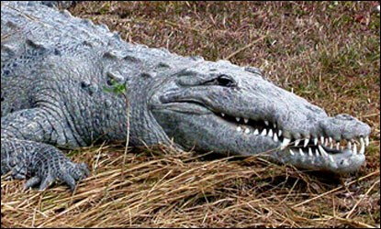
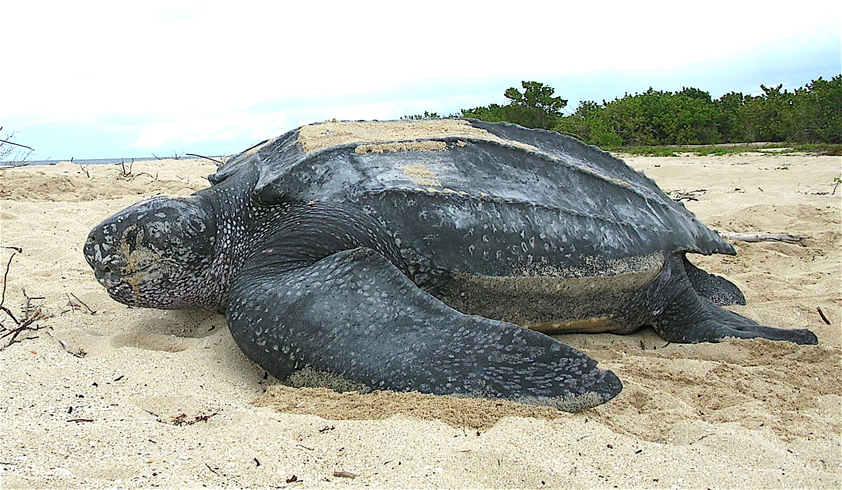
Our Hypothesis
Hypothesis:
Originally, we thought that the turtle and the alligator would be most closely related.
Reason:
We thought this because they have similar habitats and appearances.
Notes:
Dalia
At first we thought that the alligator and chicken would be the most closely related, because they have similar habitats and appearances.

Slide 7
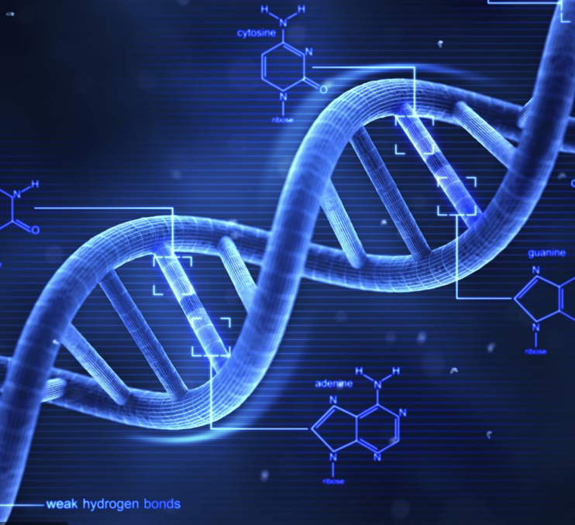
Which gene are we looking at?
We are looking at the DNA of a chicken, an american alligator, and a leatherback sea turtle to see which one was most related
Notes:
Taru
In our project, we will be looking at the DNA of 3 different animals, the american alligator, the chicken, and the leatherback turtle to see which two animals were the most closely related out of the 3

Slide 8
Project goals:
Finding the correct similarities between the species
To attempt the coding challenges if we had time
And figuring out how to use blast
Why code?
Code makes it easier for us to see the similarities and DNA structure of the animals, and it saves us time from searching it up
Notes:
Khadeja
Our project goals were to find the correct similarities between the species, to do an attempt at the coding challenges if we had time to spare, and to figure out how to use BLAST. The reason we chose code is because coding makes it easier and a bit faster for us to get the results we need

Slide 9
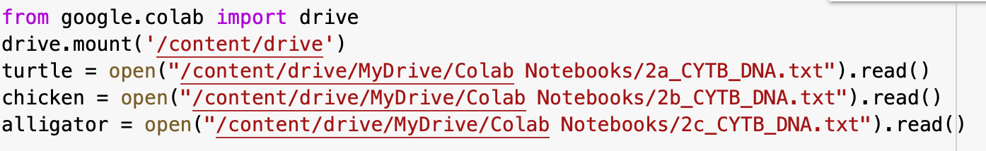
Coding slide #1
First, we mounted our google drive so that our files were accessible
Then, we assigned each file to a variable.
Notes:
alicia

Slide 10
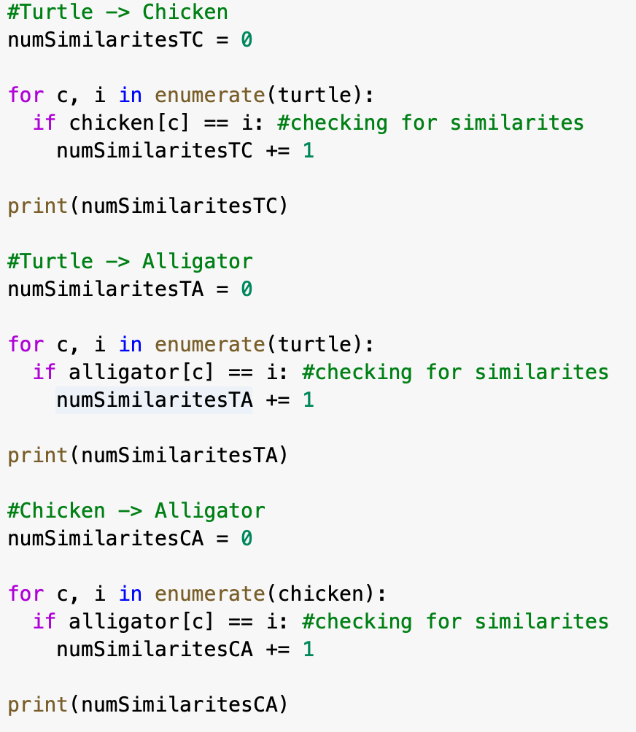
Coding slide #2
Notes:
Dalia
This code checks the number of similarities in the DNA of each species. First we made a counter to keep track of the number of similarities, then we used a for loop to go through both the turtle and the chicken file. If there was a similarity, it was added to the counter. Then we repeated this two more times to compare the rest of the animals.

Slide 11
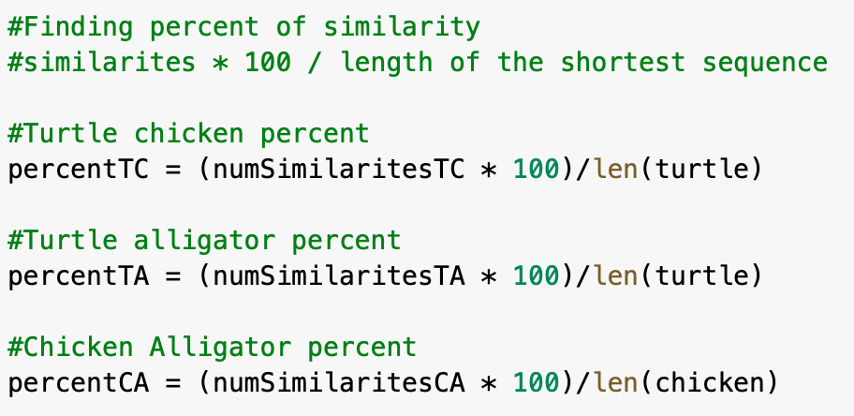
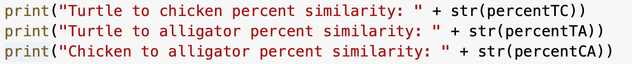
Coding slide #3
Notes:
Taru
In this code, we filled out the formula for the percent of similarities between the different species and we filled it out with our data of the alligator chicken and the turtle. We then printed the code out to see exactly what values we were getting.

Slide 12
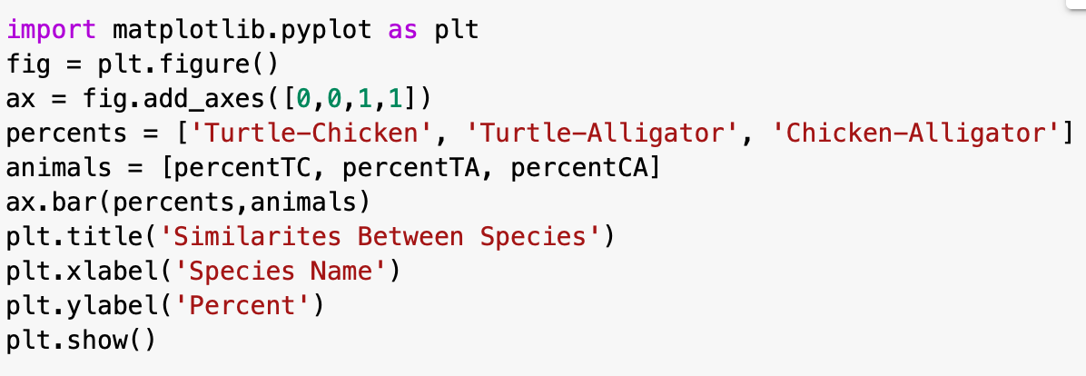
Bonus challenge
Notes:
Khadeja
For the bonus challenge, the first thing we did was import matplotlib.pyplot for the graph. Then we created a figure and added an axis, and then we added the name for the percents and animals. We finished the graph by adding the title and the x and y labels.

Slide 13
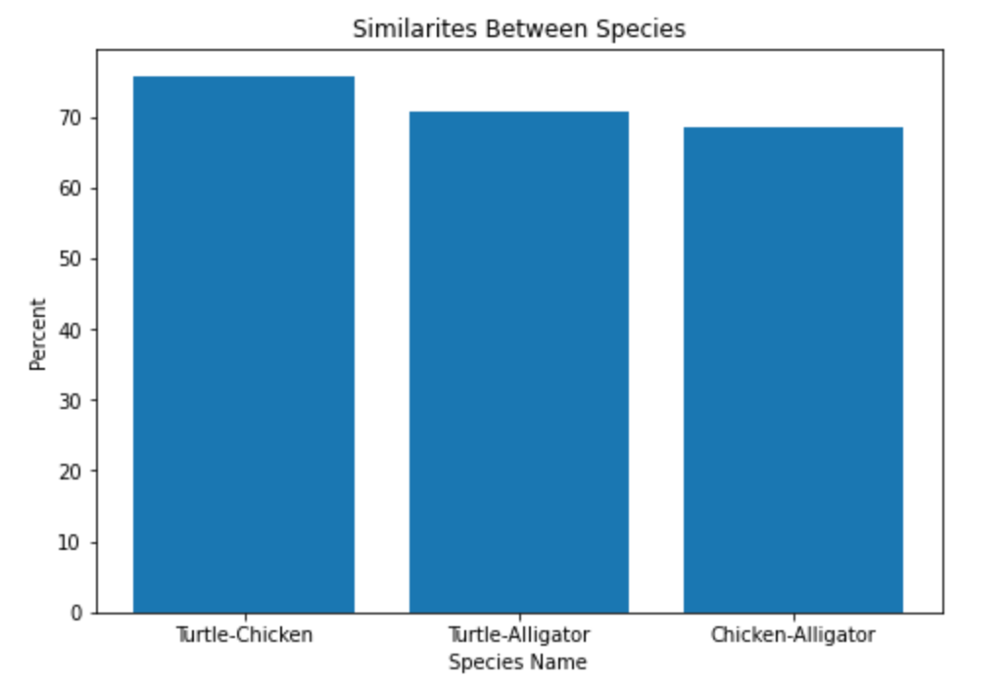
Bar Graph
Notes:
alicia

Slide 14
Scientific conclusion
In conclusion, our code told us the Turtle was most closely related to the Chicken.
In our Jupyter notebook, we coded it so that the data would show us which two animals had the greatest amount of similarities.
The most similarities were found between the Chicken and the Turtle with a total of 848 similarities and only 27 differences.
Notes:
Taru
-Although our code told us that the turtle was most closely related to the chicken, the alligator is actually most closely related to the chicken.

Slide 15
Problems and how we solved them:
Problems:
Trying to figure out which animal data was in which file.
Figuring out how to use blast
Our code gave us the wrong result-
Solutions:
We solved this by copying the sequence from our code after we opened the file and pasting it into Blast. We then figured out which animal was which by noticing which of the sequences matched our sequence in the code.
After asking help from a junior TA, we played around with it a bit and we got the data we needed
We got some help from Miss Carol and she told us to do the RNA and protein sequence as well.
Notes:
Khadeja
Our problems were trying to figure out which animal data was in which file. We solved that by copying our sequence from the code after the file was opened and pasting it into BLAST, and whichever animal matched the sequence there matched the one of our code, we knew which animal it was. Another problem was figuring out how to use blast. We asked for help from a junior TA and player around with the website a bit to figure out on how to use it. Our last problem was that our code was actually wrong, so with help from Miss Carol we were told to do the RNA and protein sequence to help us

Slide 16
Next Steps for Our Project
Our next steps for our project would be to create a program similar to BLAST, but much more simplistic so inputting and outputting data would not be as much as a hassle. Additionally, we would try to fix our code since it has a fluke and was showing us the wrong end results. Next time we would also like to add a slide comparing the protein and RNA of the animals.
Notes:
alicia

Slide 17
Thank you for listening!
Notes:
alicia

